Slide 1

A Project on
Fingerprint-Based Blood Group Detection Using Deep Learning and Image Processing
Submitted by
PARASURAM T 512221205012
PARASURAMAN K 512221202013
GUIDE
Dr. V. RAJI, M.E., Ph.D.,
Department of Information Technology
Notes:
1

Slide 2
Abstract
1
Blood group prediction is crucial for medical diagnostics and emergency care.
2
Traditional methods require blood samples, lab equipment, and time-consuming procedures, making them impractical in urgent situations.
This study explores a non-invasive approach using fingerprint images and deep learning (CNNs) to detect blood groups.
3
Faster and more efficient than conventional methods.
Reduces dependency on laboratory facilities.
Enhances accessibility for real-world medical applications.
Extensive experimentation validates the feasibility of this technique for practical use in healthcare.
Notes:
2

Slide 3
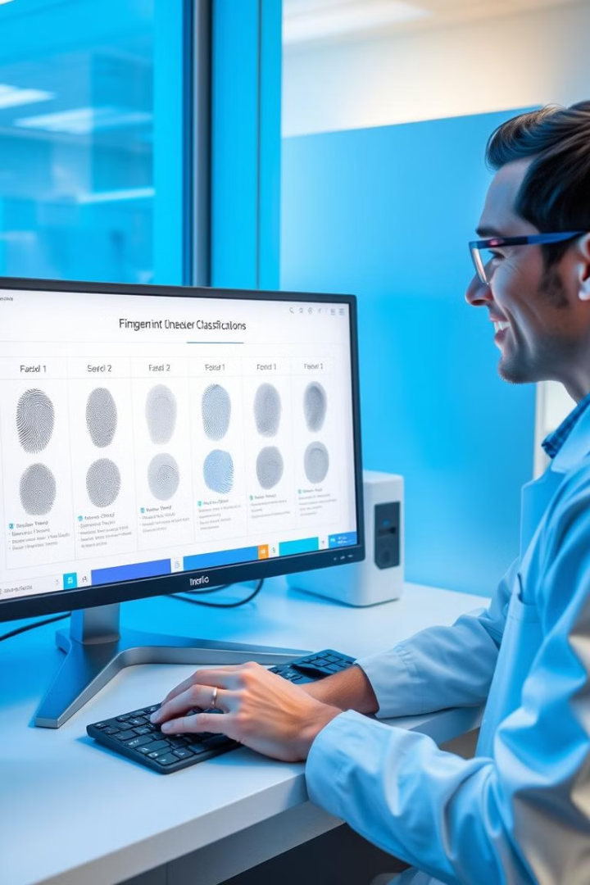
Aim & Objectives
Aim
To develop a non-invasive and automated blood group detection system using fingerprint images and deep learning.
Objectives
To collect and preprocess fingerprint images labeled with blood groups.
To implement and compare deep learning models (LeNet5, AlexNet, VGG16, and ResNet34).
To evaluate the models based on accuracy, precision, and recall.
To identify key fingerprint features correlated with blood groups.
Notes:
2

Slide 4
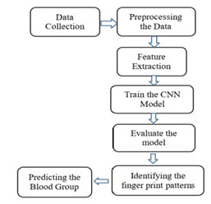
Methodology
Existing Methods
Serological Testing: Requires blood sample mixing with antibodies.
Automated Blood Typing Systems: Optical sensors analyze blood reactions.
Genotyping: Uses molecular techniques for antigen detection (costly & complex).
Proposed Method
Preprocessing includes image normalization, noise reduction, contrast adjustment.
Uses fingerprint images for blood group prediction.
Feature extraction: Identifies ridges, bifurcations, and minutiae points.
Applies Convolutional Neural Networks (CNNs) to detect blood group patterns.
Models are trained and validated using LeNet5, AlexNet, VGG16, and ResNet34.
Uses datasets of 6000 fingerprint images, labeled with blood groups.
Notes:
4

Slide 5
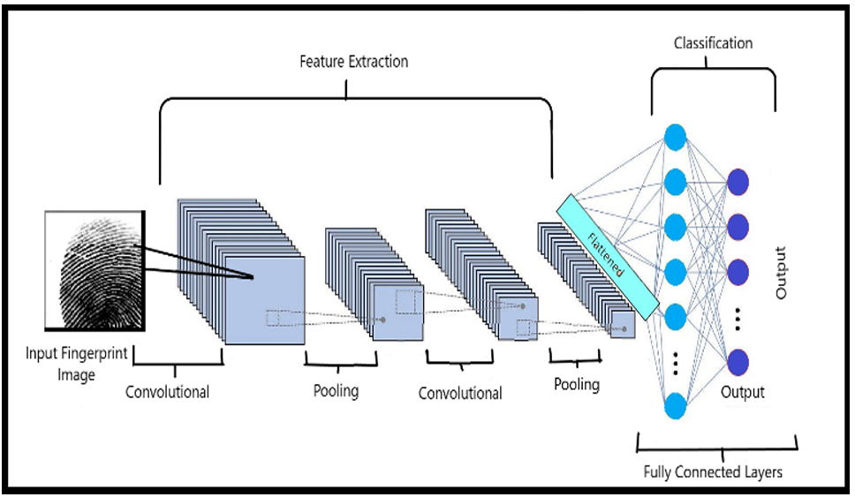
Proposed Framework
Step 1: Data Collection
6000 labeled fingerprint images
Step 2: Preprocessing
Grayscale conversion, Normalization, Denoising
Step 3: Feature Extraction
Minutiae points, Ridge endings, Bifurcations
Step 4: Model Selection
Comparing CNN architectures
Step 5: Training & Evaluation
Accuracy, Precision, Recall metrics
Step 6: Blood Group Prediction
Deploy best-performing model
Notes:
5

Slide 6
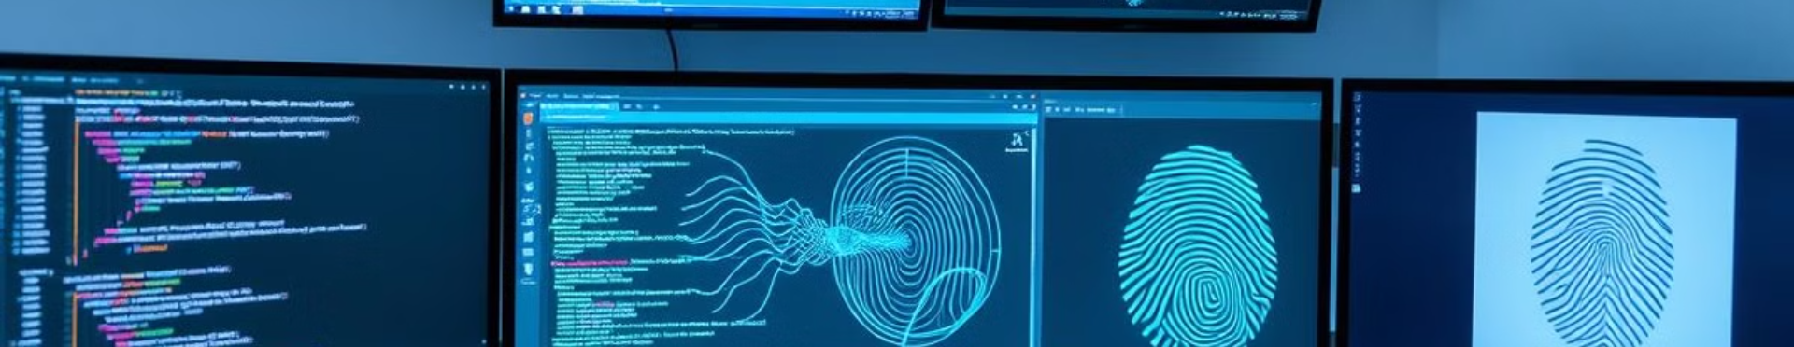




Software Requirements
Programming Language
Frameworks & Libraries
Tools
Database
Jupyter Notebook
CSV dataset containing fingerprint images with labeled blood groups
Python
TensorFlow
Google Colab
Keras
OpenCV
NumPy
Pandas
Notes:
6

Slide 7

Architecture Diagram
Step 1: Input Stage
A fingerprint image is provided as input.
The image is preprocessed before being passed into the CNN model.
Step 2: Feature Extraction (CNN Layers)
Convolutional layers detect patterns and edges in the fingerprint.
Pooling layers reduce the size while preserving essential features.
Step 3: Flattening & Fully Connected Layers
Step 4: Output Stage
Extracted features are flattened into a 1D vector.
The model predicts the blood group (A, B, AB, O, etc.) with high accuracy.
The fully connected layers classify the fingerprint into a blood group category.
Notes:
6

Slide 8
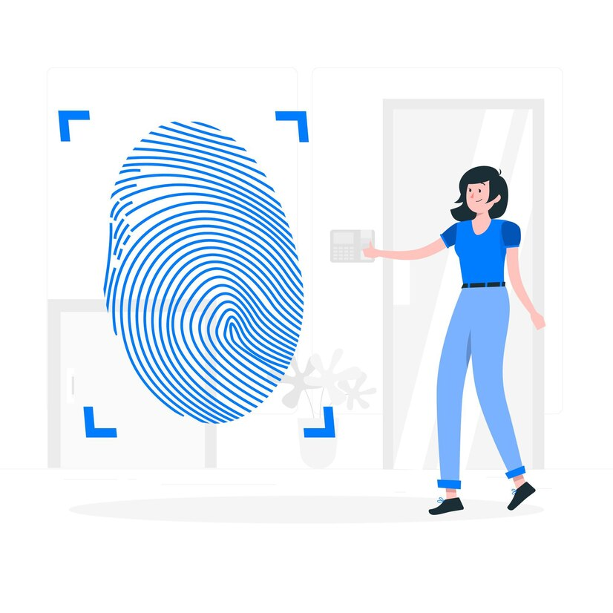
Thank You!
Notes:
10

